Slide 1
PRE-PROPOSAL MEETING,
January 16, 2018
Contract No.: 070735
Maintenance Mezzanine
and Shed Heating

Slide 2
Presenters
JULI TUSON
CONTRACTS & PROCUREMENTS ANALYST
Stan Ryter
PROJECT MANAGER

Slide 3

Agenda
Solicitation Info
Scope of Work
Site Visit

Slide 4
Procedural Issues
Contact with The Port of Tacoma
Juli Tuson, Contracts & Procurements Analyst
Interpretation or Changes to Solicitation
Clarifications/Addenda – only information published on the website is binding
All Information is Posted on the Website
www.portoftacoma.com (Contracts, Procurement, Bid 070735)

Slide 5
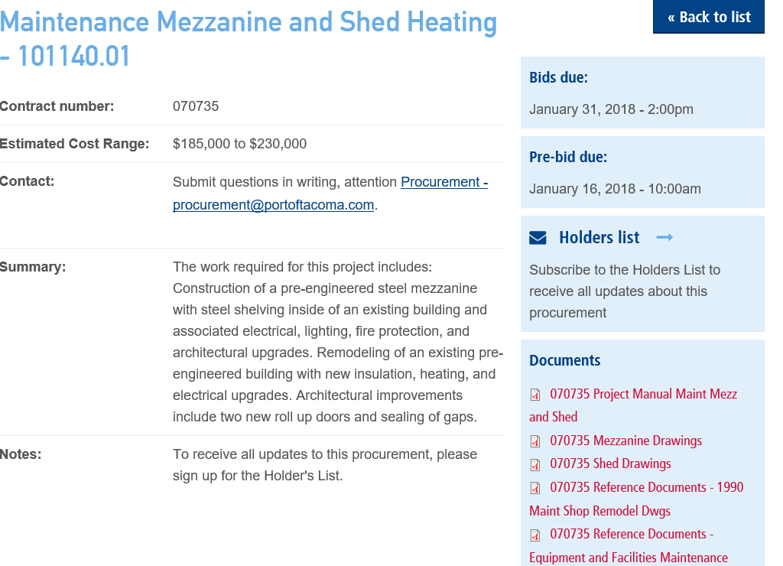
HOLDER’S LIST

Slide 6
BID INFORMATION
INSTRUCTIONS FOR BIDDING
Bids due January 31, 2018 at 2:00PM PST
Front Reception Desk, Port Administration Office, One Sitcum Plaza, Tacoma, WA
Bidding Security: Each bid must be accompanied by a Certified Check or Security Bond in the amount equal to 5% of the bid.
Award made to the apparent low bidder.

Slide 7
Insurance
Port of Tacoma as Additional Insured by endorsement -
Ongoing and Completed Operations
Also by endorsement –
Express Waiver of Subrogation
Contractor’s policy is primary and not contributory
Policies -
Commercial General Liability
Comprehensive Auto
Except where noted – limits shall not be less than $2,000,000 for each occurrence and $2,000,000 in the aggregate
Washington State Worker’s Compensation Fund and evidence of Stop Gap Employer’s Liability Insurance
Contractor is solely responsible for determining if United States Longshoremen’s and Harbor Worker’s Act (USL&H) and Jones Act are required for this project.

Slide 8
Bonds – Performance & Payment

Slide 9
Scope of Work
Stan Ryter
Project Manager

Slide 10
Scope of Work
The work required for this project includes:
Construction of a pre-engineered steel mezzanine with steel shelving inside of an existing building and associated electrical, lighting, fire protection, and architectural upgrades.
Remodeling of an existing pre-engineered building with new insulation, heating, and electrical upgrades. Architectural improvements include two new roll up doors and sealing of gaps.

Slide 11
Scope of Work
  Bid Documents Include:
  Project Manual
  Mezzanine Drawings
  Shed Drawings
  Reference Documents – 1990 Maint. Shop Remodel Dwgs
  Reference Documents – Equip & Facilities Maint. Building Architectural

Slide 12



Questions and Answers
Juli Tuson
Procurement & Contracts Analyst

Slide 13

Site Visit
Everyone that participates in the Site Visit MUST complete and sign off on the “Release and Acceptance of Responsibility and Acknowledgement of
Risks” form.
Please hand the completed and signed form to the driver of the vehicle you ride in.

