Slide 1
Ten Year Road and Rail Study
For a Six Million TEU Gateway
Eric Hanson & Christine Wolf, NWSA Planning

Slide 2
Beyond capital expenses for making terminals “big ship ready,” what off-terminal road and rail infrastructure investment will be needed to support our Strategic Vision for the container business?
Question:
To answer this question, this study identified:
Off-terminal infrastructure needs
Priority projects addressing these needs
High level project cost estimates
Notes:
Inform Capital Budgeting
Support Competitive Grant Applications
Local and Regional Project Coordination
Project Permitting Support

Slide 3
Base Conditions and Assumptions
Total NWSA container volume = 6 million TEUs / Year 2026
  Basically a doubling of volume from 2015
3 million TEUs each Port area – North and South Harbors
  1.8 million TEUs intermodal each harbor (on & near-dock)
  1.2 million TEUs trucks each harbor
“Big Ship Ready” terminals in each harbor

Slide 4
T-5 “Big Ship” Phases
N
4

Slide 5

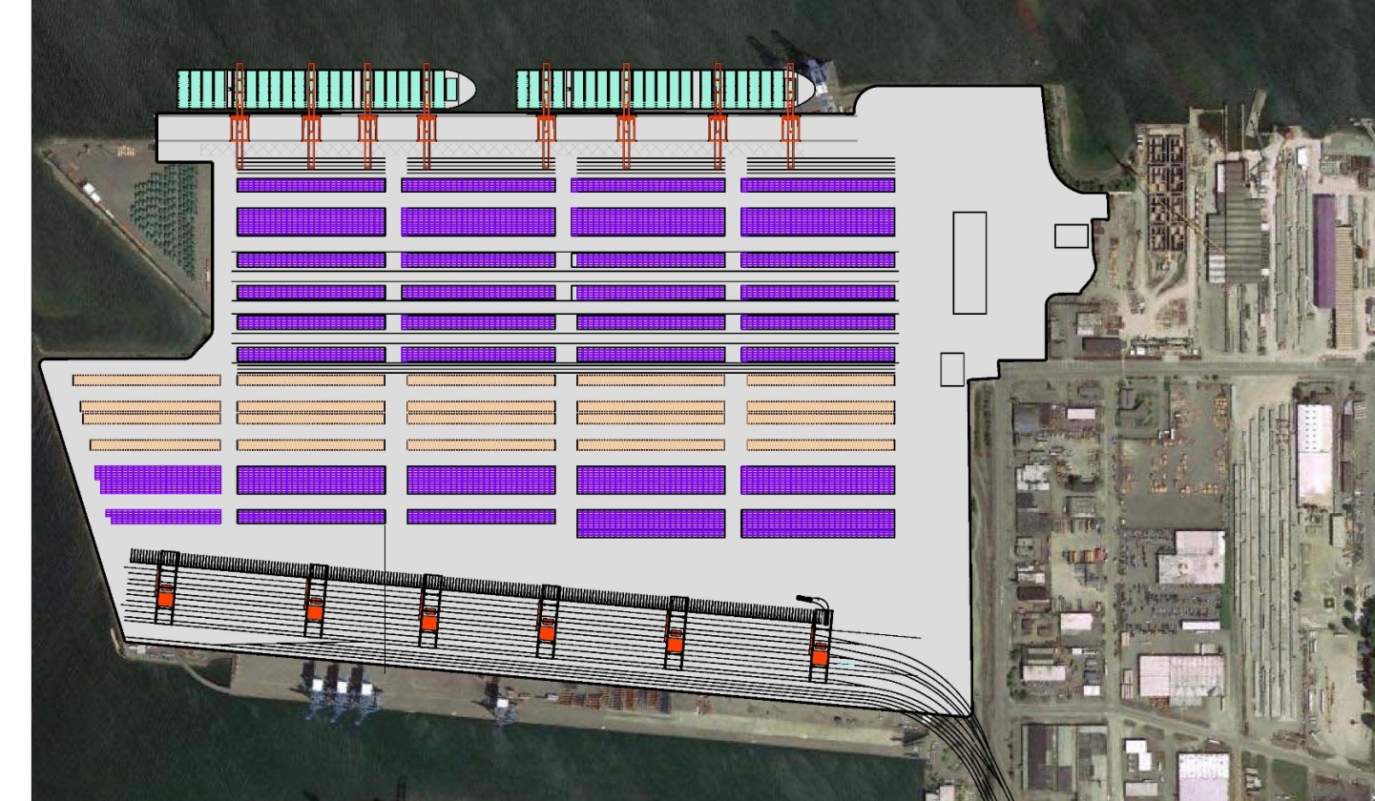




GCP “Big Ship” Phases
Phase 1
Complete
Phase 2
Phase 2A
Phase 2A
Phase 3
5

Slide 6
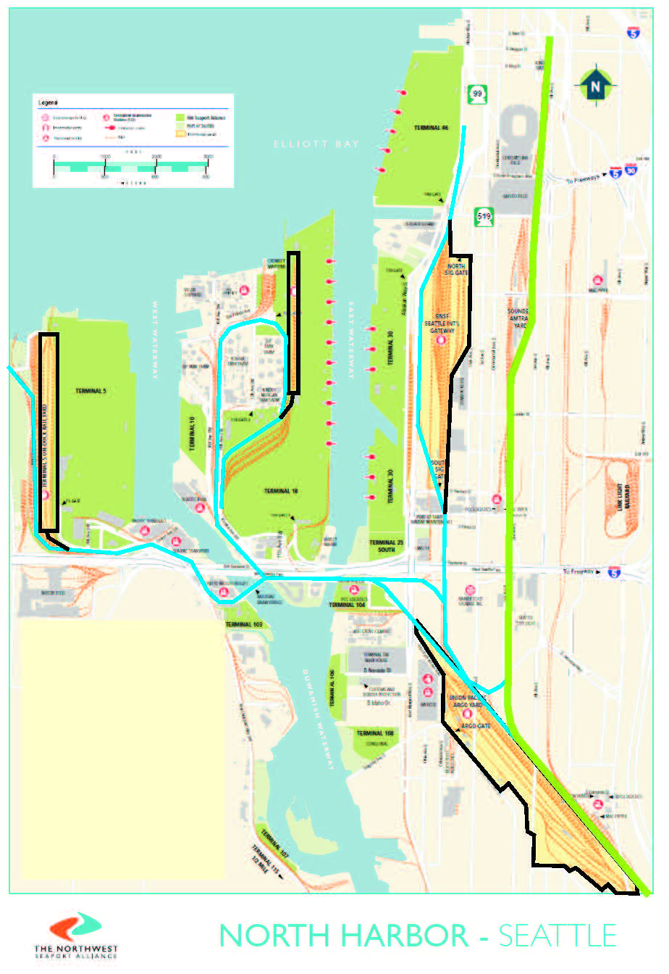
Rail – North Harbor
Intermodal Yards
Terminal 5 On-Dock
Terminal 18 On-Dock
BNSF SIG Near Dock
UPRR ARGO Near Dock
2
1
3
4
6

Slide 7
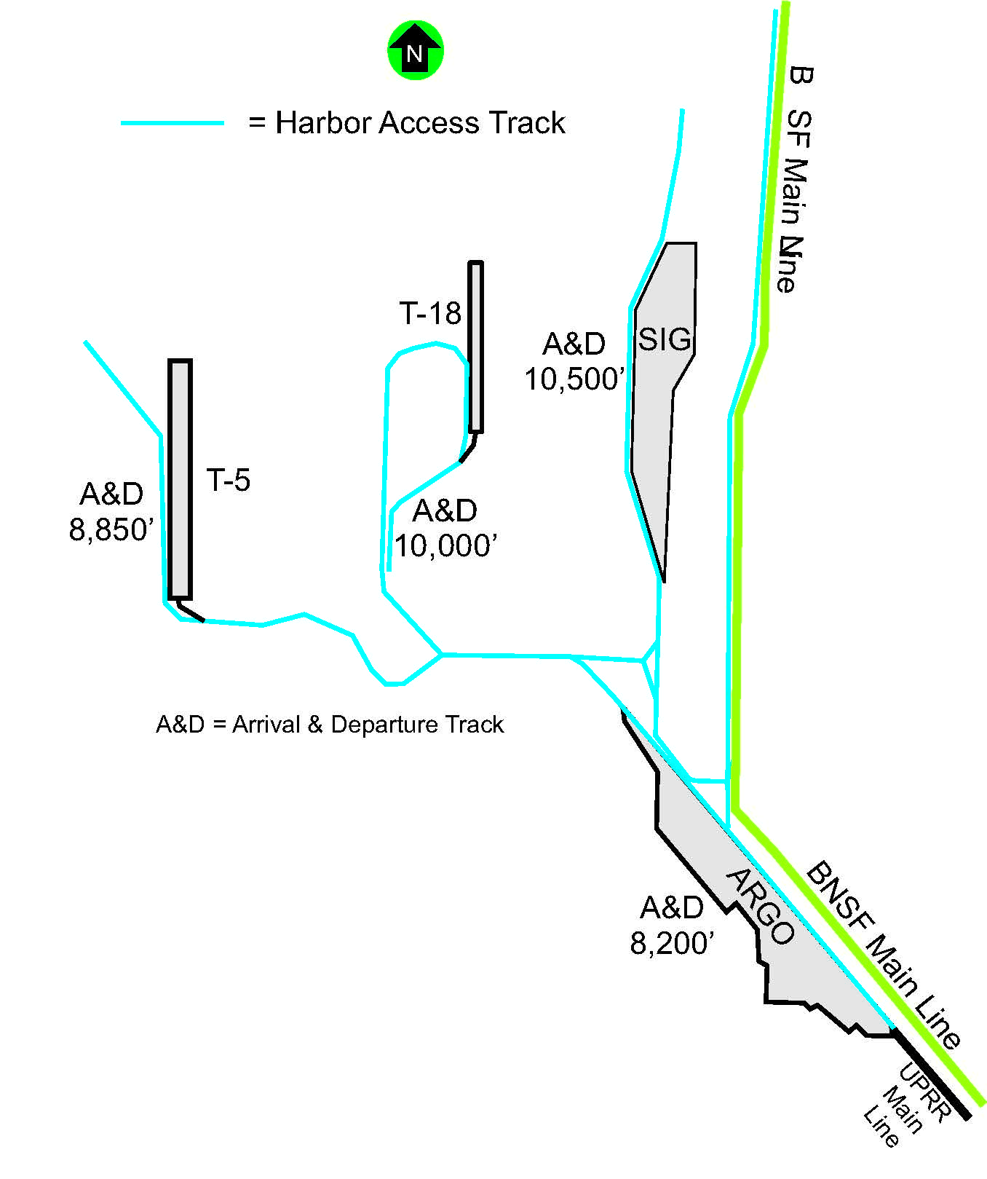
Rail Capacity – North Harbor
Intermodal Yard & Train Staging
Intermodal yard capacity target = 1.8 million TEUs. Train length target = 8,000’
BNSF Main Line
Future IY capacity exceeds future target by 32%
Can handle multiple 8,000’ trains
Intermodal Yards | Current Capacity (Annual TEUs) | Future Capacity (Annual TEUs)
BNSF SIG Yard | 525,000 | 1,000,000
UPRR ARGO Yard | 380,000 | 380,000
Terminal 5 | 380,000 | (Strategic Terminal) 850,000
Terminal 18* | 140,000 | 140,000
Totals | 1,425,000 | 2,370,000
*T-18 capacity limited due operational impacts on CY
Lift to TEU conversion: 1 Lift = 1 TEU x 1.75

Slide 8
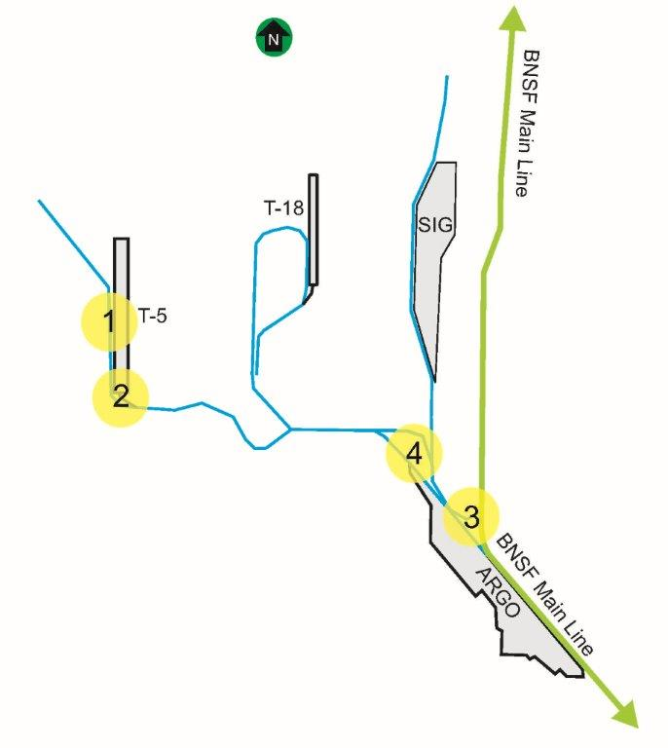
Rail Capacity – North Harbor
Minor recommended capacity improvements
Project Name | Funding | Estimated Project Cost Total
1. 8,000’ storage track | NWSA POS Stakeholders? | $7 million
2. Additional switch | NWSA POS | $1 million
3.* 900’ track extension | Railroads | $1 million
4.* Double track ARGO to Harbor Island | Railroads | $7 Million
* Projects #3 and #4 require joint use UPRR / BNSF track agreements

Slide 9
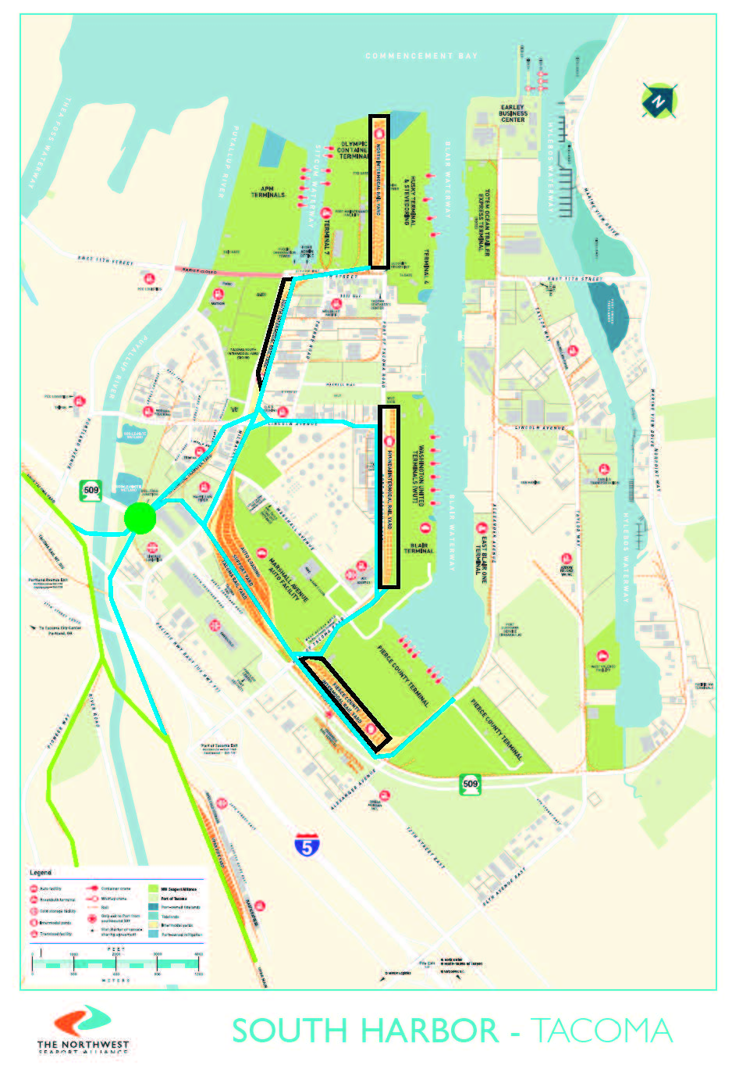
Rail – South Harbor
Intermodal Yards
1
4
North Intermodal (NIM)
Washington United Terminals (WUT)
Pierce County Terminal (PCT)
South Intermodal (SIM) (Domestic)
2
3

Slide 10
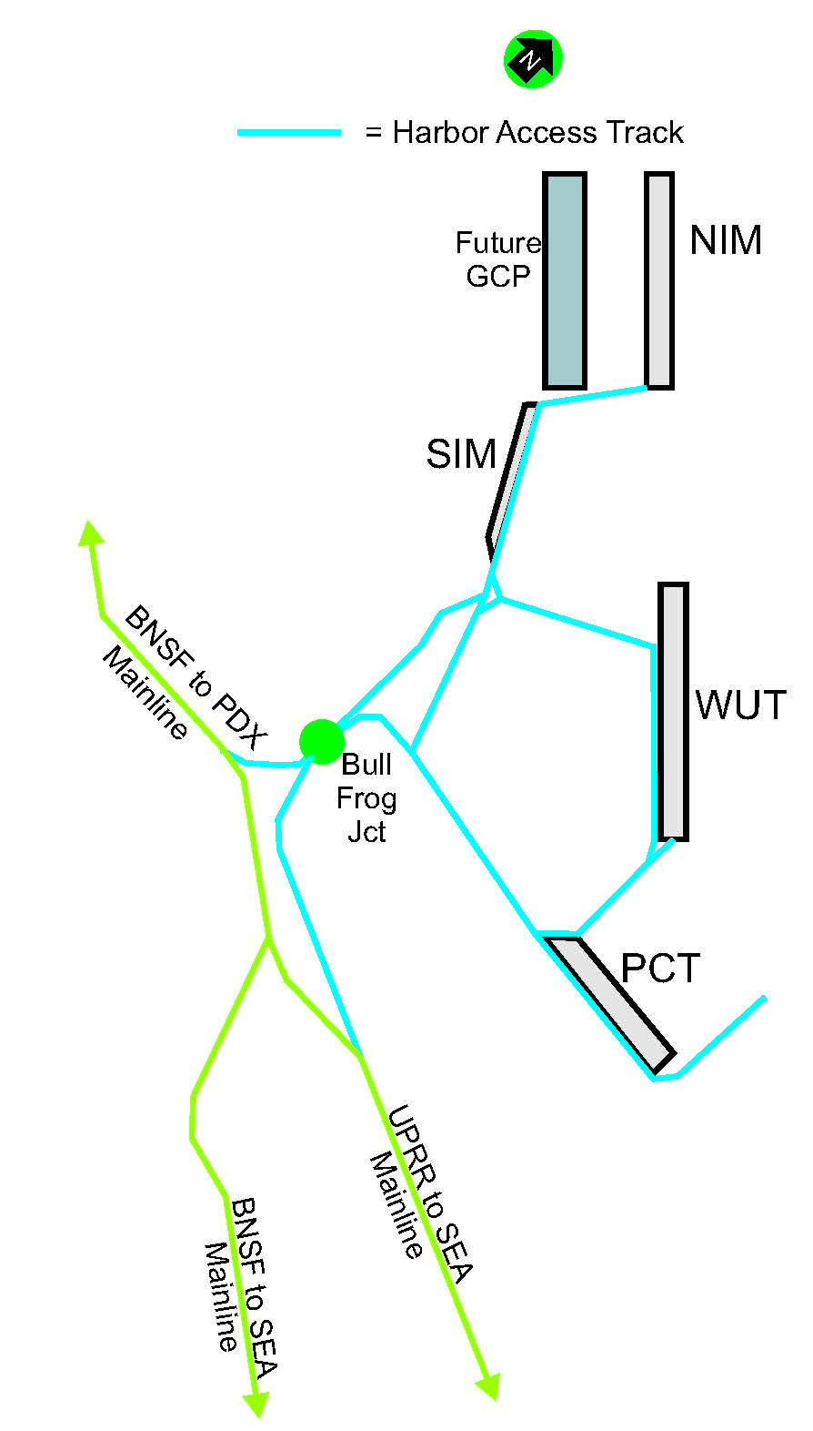
Rail Capacity – South Harbor
Intermodal Yard
Intermodal Yard capacity target = 1.8 million TEUs.
Future IY capacity exceeds future target by 29%
Intermodal Yards | Current Capacity (Annual TEUs) | Future Capacity (Annual TEUs)
1. North Intermodal Yard | 700,000 | (Strategic Terminal, Future GCP IY) 1,300,000
2. Washington United Terminal | 350,000 | 350,000
3. Pierce County Terminal | 675,000 | 675,000
Totals (w/o SIM) | 1,725,000 | 2,325,000
1
2
3
Lift to TEU conversion: 1 Lift = 1 TEU x 1.75
10

Slide 11
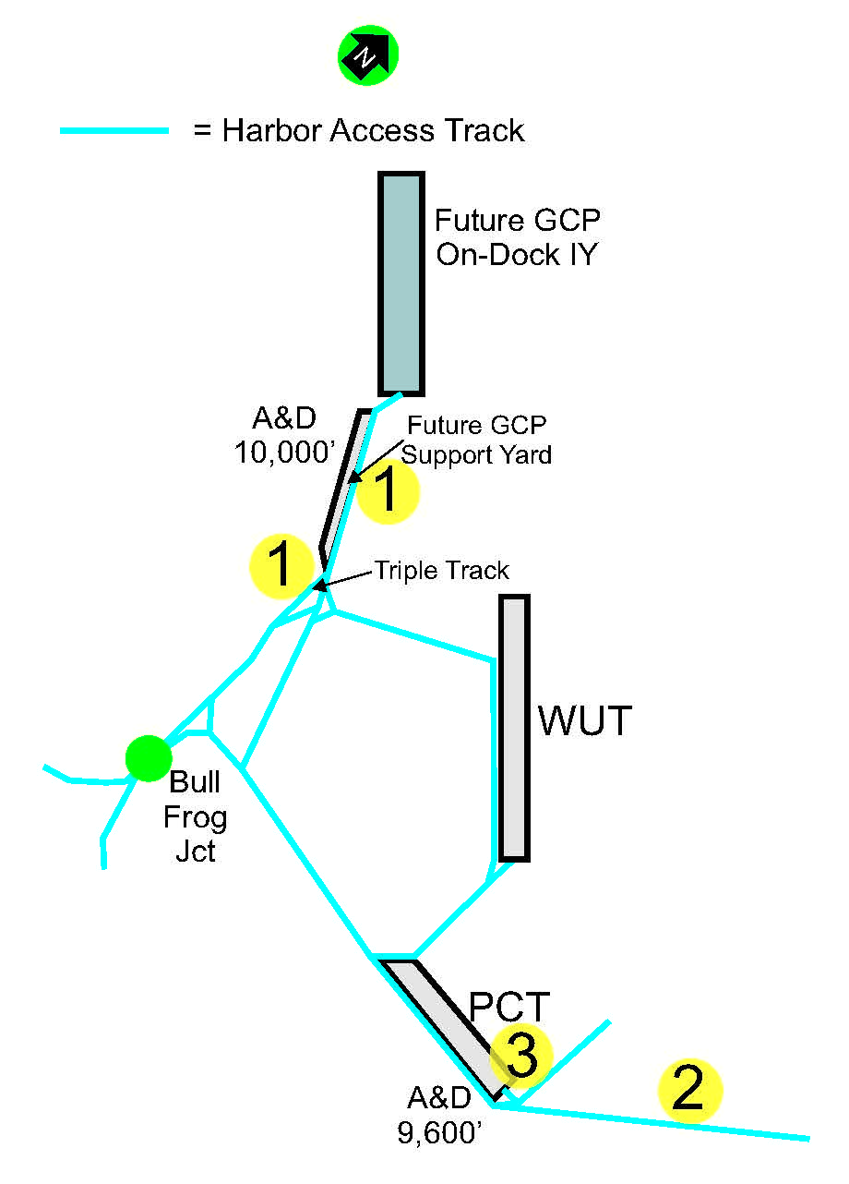
Rail Capacity – South Harbor
Train staging
Recommended improvements inside Tideflats
needed to handle multiple 8,000’ trains
Project Name | Funding | Estimated Project Cost Total
1.* New GCP IY Support Infrastructure | NWSA POT Stakeholders? | $45 million
2. New Long Lead Tracks | NWSA POT Stakeholders? | $20 million
3.** Double end PCT IY | NWSA POT Stakeholders? | $50 million
* Does not include costs to modify NIM (on-terminal cost) of $70 million + potential
disposal costs for contaminated soils
** Needs further cost benefits analysis. Cost estimate not included in Slide #23 totals.

Slide 12
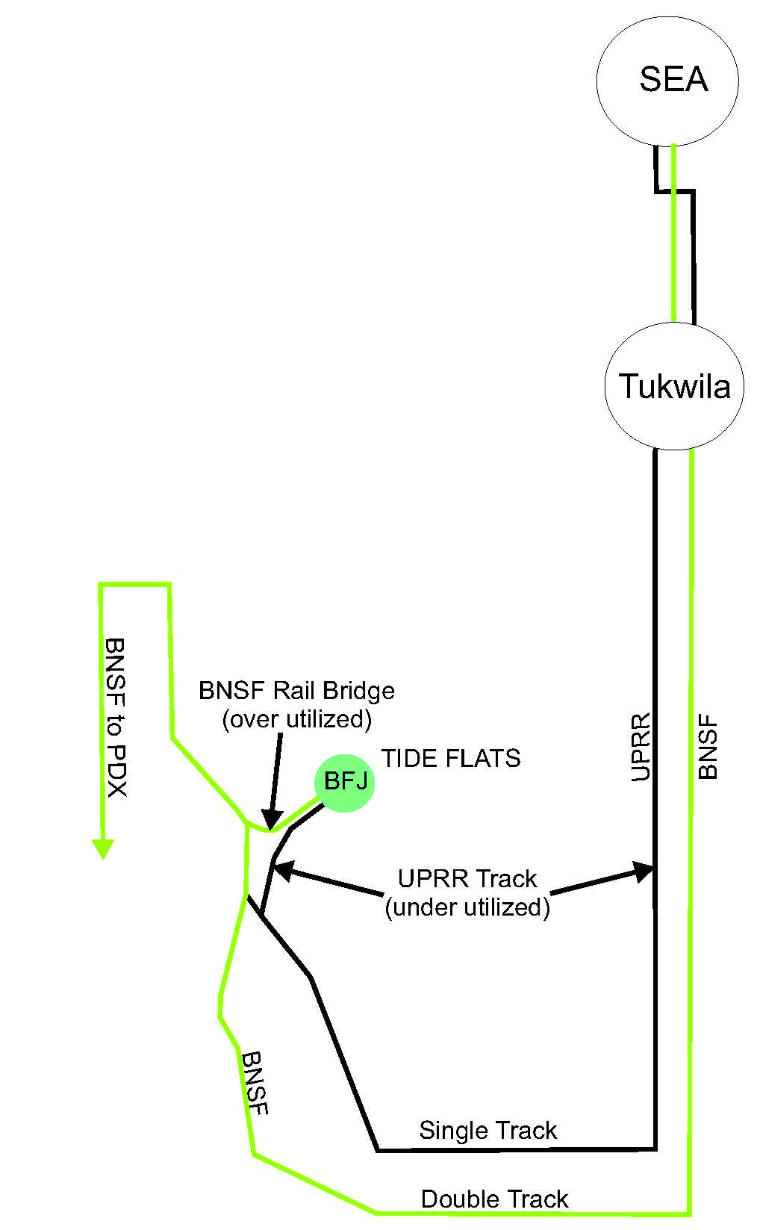
Rail Capacity – South Harbor
Mainline Access
Sound Transit and
Amtrak use BNSF Line
2026 Train Forecast @ 3 Million TEUs
TEU | 1,800,000
lifts | 1,028,571
train size | 8,000
total CNTR trains/day | 14
SIM | 0
Autos | 2
Oil | 2
Other Commercial | 1
Subtotal | 19
Peak Factor | 10%
Total (rounded) | 21
Does not include 13-20 daily moves for equipment
repositioning and other ancillary moves
BNSF Rail Bridge Daily Capacity = 22-24 trains
2026 train forecast likely to exceeds
capacity of bridge
UPRR track underutilized for Tideflats access

Slide 13
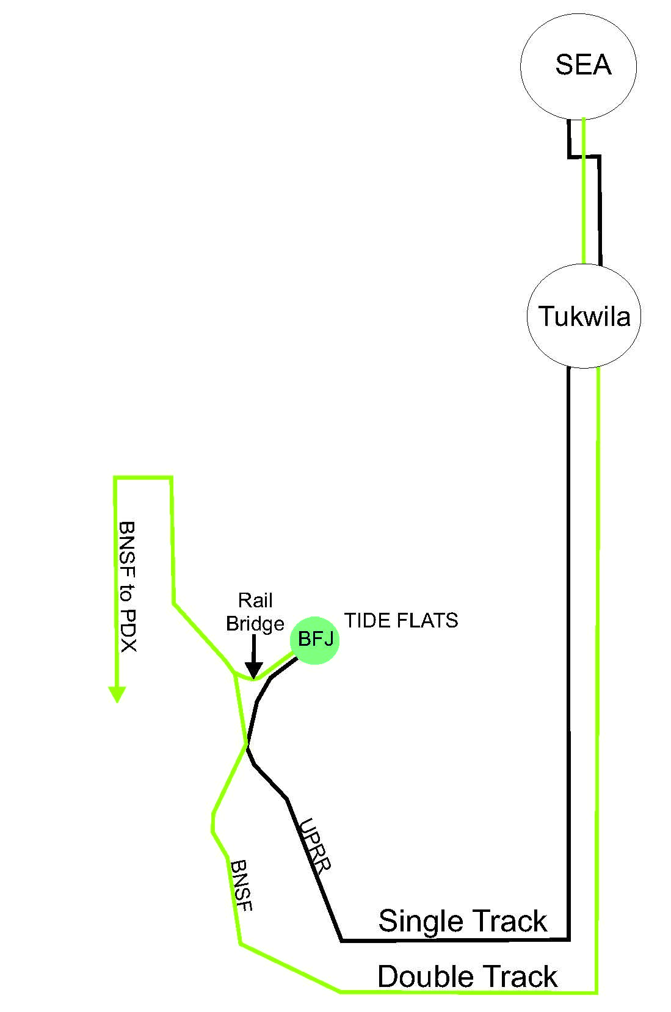
Rail Capacity – South Harbor
Mainline Access Recommendations
Sound Transit and
Amtrak use BNSF Line
2
Project Name | Funding | Estimated Project Cost Total
1. The 2nd BNSF bridge across Puyallup | BNSF Stakeholders? | $55-$75 million
2. Share tracks SEA-TAC | UPRR BNSF Stakeholders? | TBD Likely less than project #1
3. UPRR to BNSF White River connection | UPRR BNSF Stakeholders? | $25-$50 million
2
2
1
Any one of the above three projects alone can likely resolve future capacity needs
Sumner
3
2

Slide 14



Roadway Methodology – Both Harbors
Screened projects for Port-related freight mobility and congestion mitigation
Defined and assigned three project categories
    Terminal Access
    Harbor Mobility
    Freeway Connection

Slide 15
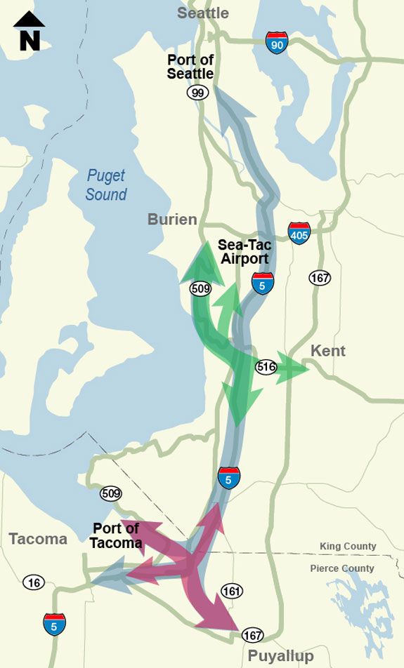

Regional Megaprojects
Alaskan Way Viaduct Replacement
Puget Sound Gateway

Slide 16
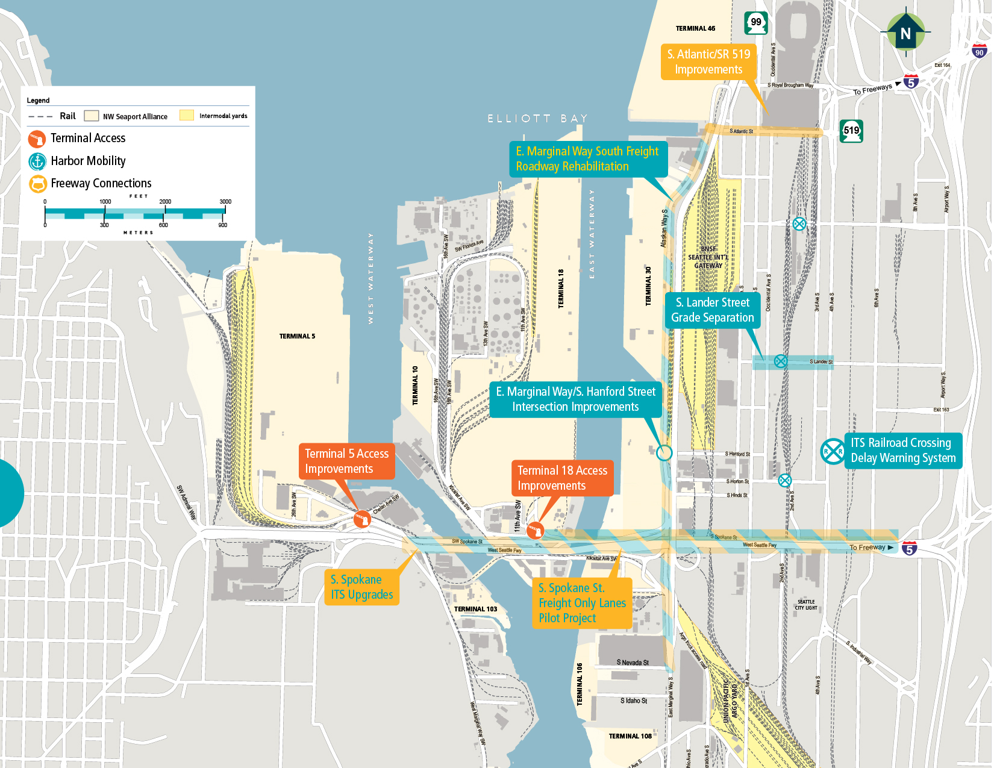
North Harbor –
Roadway Projects

Slide 17

North Harbor – Roadway Priority List
Project Name | Project Need | Project Type
 |  | Gate | Intersection | ITS Application | Grade Separation | Pavement
T-5 Access
T-18 Access
East Marginal Way Rehabilitation
S. Spokane Truck-Only Lanes
S. Spokane ITS
EMW/Hanford/Main SIG Intersection
Heavy Haul (Not EMW)
RR Crossing Delay Warning System
S. Atlantic Corridor
S. Lander Grade Separation

Slide 18
North Harbor – Roadway Cost Estimates
Project Name | Lead Agency | Estimated Cost
T-5 Access | NWSA / POS Stakeholders? | $3.5-5 million
T-18 Access | NWSA / POS Stakeholders? | $3-4 million
East Marginal Way Rehabilitation | City of Seattle | $48 million
S. Spokane Truck Only-Lanes | City of Seattle | $4.5 million
S. Spokane ITS | City of Seattle | $1.5 million
EMW/Hanford/SIG Intersection | City of Seattle | $13 million
Heavy Haul System (Not EMW) | City of Seattle | TBD
RR Crossing Delay Warning | City of Seattle | $0.5 million
S. Atlantic Corridor | City of Seattle | TBD
S. Lander Grade Separation | City of Seattle | $140 million

Slide 19
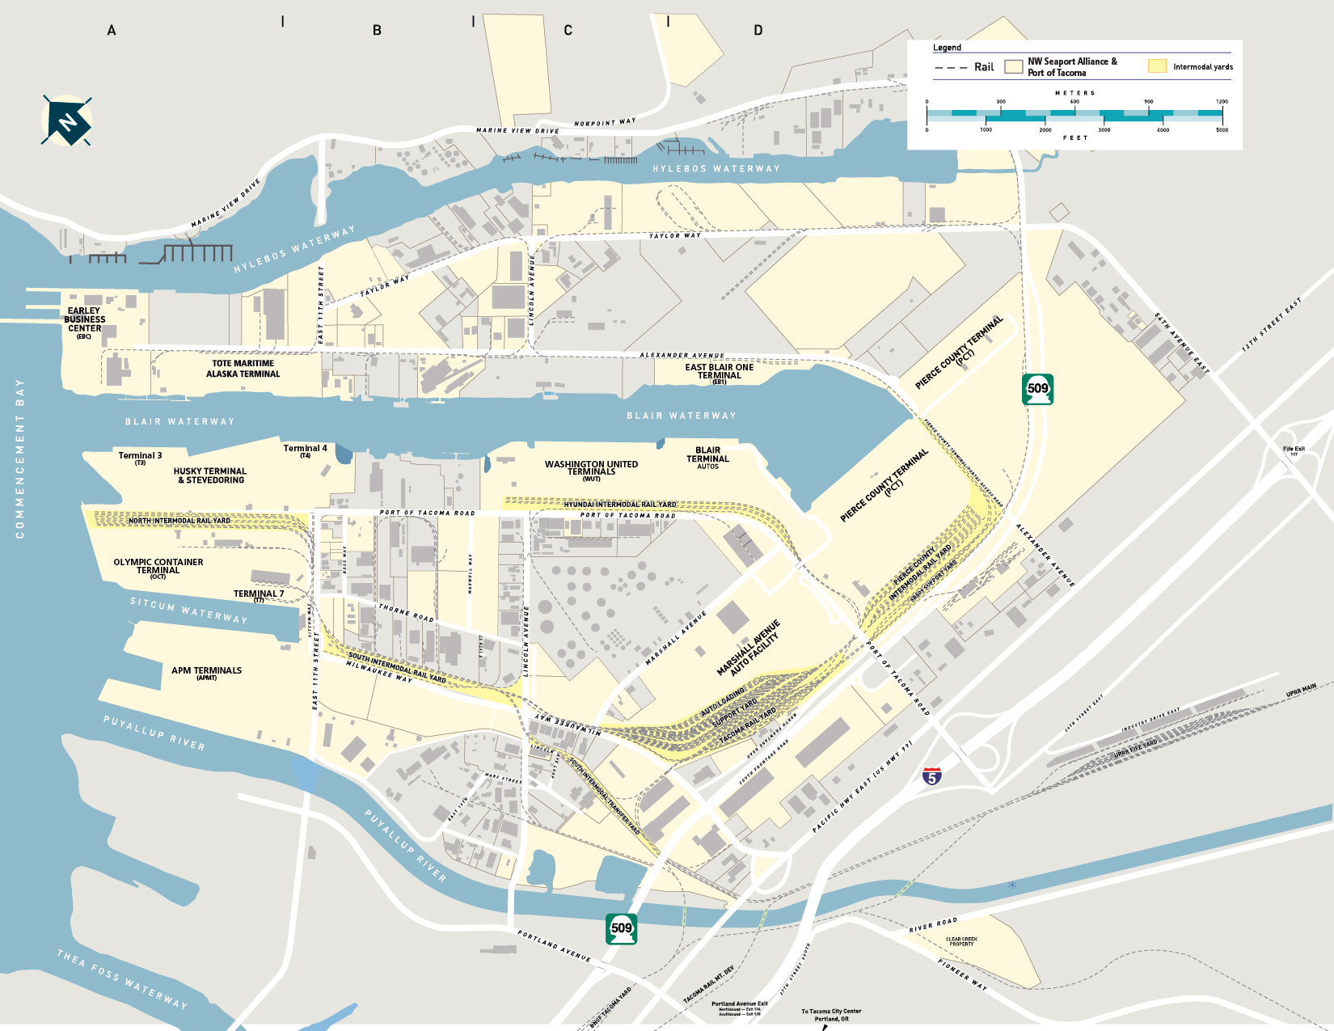
Road System – South Harbor
South Harbor – Roadway Projects
Taylor Way Heavy Haul
SR 167 Extension
SR509/Taylor/54th Intersection
Arterial ITS Program
Arterial ITS Program
Tideflats ITS Program
GCP Access
I-5/54th Interchange
Port of Tacoma/I-5 Interchange
Old Pacific Hwy Bridge Sections
Lincoln Ave. / Puyallup River Capacity Improvement
19

Slide 20
South Harbor – Roadway Priority List
Project Name | Project Need | Project Type
 |  | Gate | Intersection | ITS Application | Bridge or Grade Separation | Pavement
Port of Tacoma Road/I-5 Interchange
Tideflats ITS Program
Taylor Way Heavy Haul
GCPT Access
SR 167 Extension
Remaining Puyallup Ave Bridge Sections
SR 509/Taylor Way/54th Ave East
Lincoln Ave Corridor/Puyallup River Capacity Improvement*
* Previously unlisted project.
20

Slide 21
South Harbor – Roadway Cost Estimates
Project Name | Lead Agency | Estimated Cost
Port of Tacoma Road/I-5 Interchange | City of Fife | $60 million
Tideflats ITS Program | TBD | $3.5 - 5 million
Taylor Way Heavy Haul | City of Tacoma | $15 million
GCPT Access | NWSA / POT stakeholders? | $2.5 million
SR 167 Extension | WSDOT | $1 - 1.5 billion
SR 509/Taylor Way/54th Ave E | City of Tacoma | $5 million
Remaining Old Pacific Highway Bridge | City of Tacoma | $120-160 million
Lincoln Ave Corridor/Puyallup River Capacity Improvement* | City of Tacoma | TBD
* Previously unlisted project.

Slide 22
Challenges
Funding
  Financial analysis yet to be completed
  Funding has not been identified for rail projects
  Contributions for partner roadway projects to be negotiated
North Harbor – freight and general traffic are heavily dependent on the same limited roadway infrastructure
South Harbor – challenged by fluidity of the road and rail system
    Cargo split forecast – determines accuracy of identified infrastructure needs

Slide 23
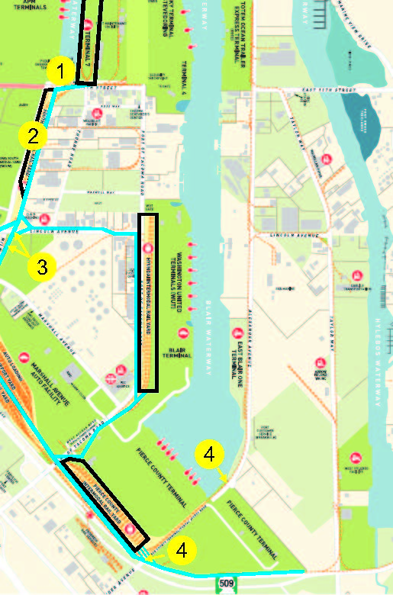
Potential Other Impacts
Project # | Description | High Level Cost Estimate
1 | POT headquarters relocation | TBD
2 | Retention of domestic intermodal service in Tideflats | TBD
3 | Milwaukee surface street connection to elevated Lincoln Ave overpass | $25 million
4 | PCT truck gate access relocation to Taylor | $4 million
5 | Emergency access / egress route improvements – Tideflats wide | TBD

